Slide 1
ENGLISH LITERARY SOCIETY

Slide 2
STORY WRITING(350 – 500)
TOPICS
English
Truth Triumphs, Falsehood is a loser
It is all about determination
Cheating is a Curse
Patience bears fruit

Slide 3
DIVISION OF MARKS
Plot 20
Diction/Vocabulary 10
Grammar 10
Characterization 10
Creativity 10
Development of story 15
Style 10
Moral 15

Slide 4
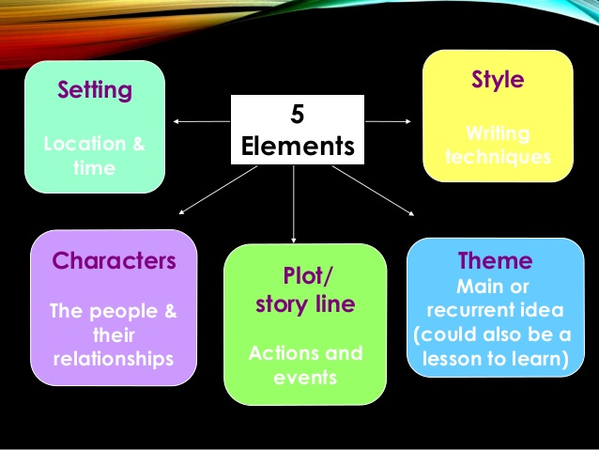
CONTENTS OF A STORY

Slide 5
ESSAY WRITING(350-500)
TOPICS
English
Equality and respect to all
To what heights can I not rise
The future of Burn Hall, as I foresee
One has to construct ones own career

Slide 6
DIVISION OF MARKS
Subject Matter 20
Creativity 15
Vocabulary 15
Grammar 15
Style 15
Development of thought 10
Conclusion 10

Slide 7
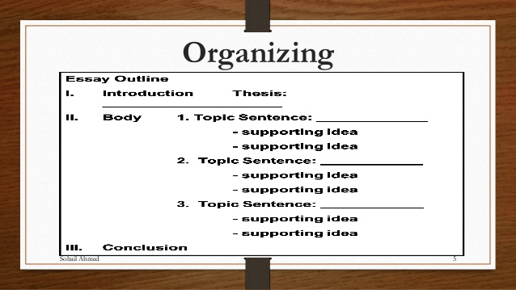

Slide 8
DEBATE
Topic
We have shattered the dreams of Iqbal.
Date 4thJuly,2018
For
  Lack of research and researchers
  Lazy and idle youth
  Youth devoid of character
  Dependent on other nations
  Lack of leadership
  Plight of Muslim Ummah

Slide 9
DEBATE
For
  Plight of Muslim Ummah
  Not Practicing Islam in its true sense
  The values have gone down
  Today is not different from 1930, hence the concerned and thought are much relevant even to day

Slide 10
DEBATE AGAINST
Against
  Trust in our Capability
  Commandership and Sacrifice
  No of Indo Pak Wars, War on Terror
  Nuclear Plant
  Scientist like Abdul Qadeer and Abdul Islam
  If we are lagging behind it is because of circumstances and hypocrisy of super powers and challenges of time

Slide 11
DEBATE AGAINST
Against
  Resilience of nation and Arms Forces, Sacrifices , the price of freedom in Kashmir, FATA & Bulchistan
  Self Reliance during tough period of restrictions

Slide 12
CONCL
  It is high time to revive and rekindle our values , culture, teaching of Islam, understanding of Quran and Poetry of Iqbal
  This is how we can bring revolutions and make develop Pakistan
  Lets not be pessimistic and build on the strengths we posses
  Lets find a silver lining and more forums

Slide 13
END

